Slide 1
TRANSITION from SCHOOL to ADULT LIFE
College
Career
Life
Notes:
Jefferson Township Roundtable
Attendance:
Share handout and SEPAG Guide Link:
Welcome everyone to the presentation, introduce yourself and poll the audience to gain a sense of the participants.

Slide 2
Workshop Overview
As a result of this workshop you will:
Have a understanding of the Transition from School to Adult Life process.
Learn ways to develop self advocacy and self-determination skills
Understand how to find information within the Family Guide to Transition Services.

Slide 3
Basic Rights of IDEA
Provision of a free, appropriate public education (FAPE) in the least restrictive environment (LRE)
Development of an individualized education program (IEP)
Notes:
IDEA (Individuals with Disabilities Education Act) ensures that children with disabilities receive a free, appropriate public education (FAPE) in the least restrictive environment.
It also provides parents with the right to participate in their children’s education. You and representatives of your school district are team members who are responsible for developing an appropriate educational program for your child.
Refer to Acronym handout in the packet.

Slide 4
Purpose of the Law
To ensure that children with disabilities receive educational benefit that allows them to progress from grade to grade, learning the knowledge and skills of their non-disabled peers
To provide the services and supports needed for your child with disabilities to become a productive adult, contributing to the community
Notes:
Need to be at the meeting
Need to share

Slide 5
Your Role and Responsibilities
An equal partner in decision-making, with the right to give or withhold consent for each evaluation and for initial services
To be at every decision-making meeting
To share your concerns for enhancing your child’s education

Slide 6
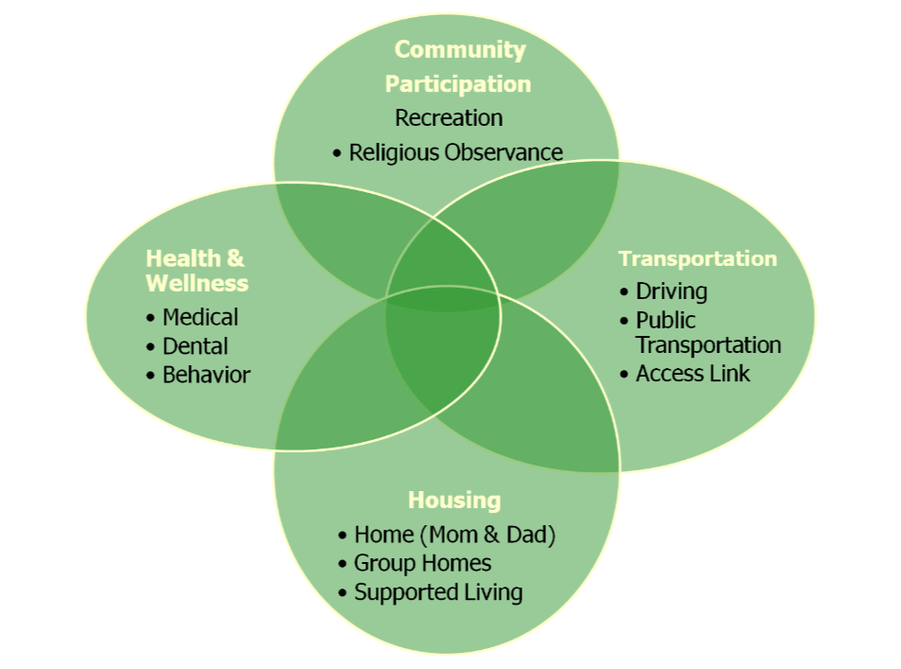
Notes:
Transition planning is all about making decisions. All of these decisions are interconnected. By breaking down the process into smaller pieces it becomes more manageable.

Slide 7
Why Is Transition Important?
It is the end of a system of entitlements, and the beginning of a system of eligibility.
Notes:
Waiting until a student is ready to graduate is too late to begin the transition process.
Each transition plan should be individualized for the student and their unique and individual needs.
It’s all about planning for the youth’s future! A future focused on the student’s desires.
There are wonderful supports available, however, it takes time and patience to identify resources and access them. Families have to learn an entirely new and different system and that can be overwhelming.

Slide 8
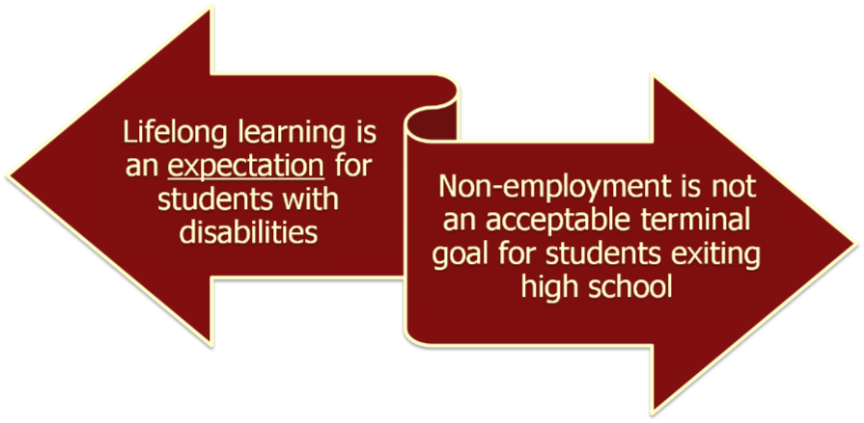
Why Focus on Transition?
Notes:
Graduating from high school is not enough – we must plan appropriately to ensure all students gain the skills needed to achieve their desired post-school goals and assume adult responsibilities in their communities.
NJ is an Employment First State – that means all students should plan for employment in some capacity.
Transition planning helps us identify what connections and supports will be needed and to put them in place.

Slide 9
When Does Transition Begin?
Statement of Transition Planning
Statement of
Transition Services
(Coordinated Activities/Strategies)
Notes:
At age 14 – Beginning with the IEP in place for the school year when the student will turn age 14, or younger, if appropriate, develop the long range educational plan for the student’s future. Review annually.
At age 16 – Beginning with the IEP in place for the school year when the student will turn age 16 or younger, if appropriate, complete a multi-year plan for promoting movement from school to the student’s desired post-school goals. The student’s needs, strengths, interests and preferences in each area (instruction, community experiences, etc.) must be considered and responsibilities should be shared among participants (student, parent, school staff, outside agencies, employers, etc.)

Slide 10
Transition Planning: IEP
Identify student’s strengths, interests and preferences
Develop measurable postsecondary goals:
Education
Employment
Community Participation
Independent Living
Courses of study
Related strategies and/or activities
Notes:
These 4 items makeup the Statement of Transition Planning that is required at age 14. It is one page of the Transition Planning section of the IEP.
Let’s examine this more closely on the next slide…..

Slide 11
Notes:
The IEP must identify the student’s strengths, interests and preferences that are based on informed decision-making. The team should discuss ways to document/collect data on this student information.
After considering the student’s interests, preferences and desired future outcome, there should be a measurable goal in each of these areas:
Education-college, vocational training, continuing ed, adult ed
Employment-volunteer opportunities, internships, part time work, work study, skill development
Community participation-scouts, recreation/leisure activities, extra curricular activities, friendships, banking, shopping
Independent living-transportation/travel training, job coaching, personal finance, nutrition
Courses of study should be tied to the goals identified, ie: college prep classes, accommodations for college classes, social skills, sports
Related strategies should help the student to achieve the skills needed to master the goals by the end of the year, ie: social skills, counseling, study skills. Brainstorm with your team to identify.

Slide 12
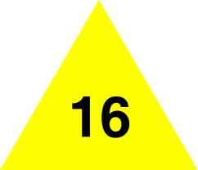
Transition Planning: IEP
Activities/Strategies Related to Measurable Post Secondary Goals:
Instruction
Related Services
Community Experiences
Employment
Adult Living
Daily Living
Functional Vocational Evaluation
Notes:
A date of implementation and the person/agency providing the service must be noted in the IEP for each of these areas.
It should not state “family” or “parents” for EVERY item.
If we seriously consider and develop a plan for each of these areas, we will have developed a good transition plan. Note the plan is review annually!
Let’s look at each of these areas of the IEP…..

Slide 13
Notes:
Instruction-where will the student continue his/her education? What is needed to ensure enrollment/acceptance?
Related Services-will the student need to continue current related services? How can they access this service.
Community Experiences-banking, shopping, transportation, recreation

Slide 14
Notes:
Employment-identify and secure jobs/ volunteer positions in the student’s area of interest. What skills does the student need to improve these opportunities.
Adult Living-SSI, voting, DVR, DDD, MH, County office on Disability, CILs
Daily Living-Self advocacy, independence, improved communication skills, residency, day programs
Functional vocational evaluation can provide data on future employment opportunities

Slide 15
Transition Planning: Measurable Goals
Goals must be measurable to ensure the student is making progress towards achieving the goal by the end of the year
Notes:
The Transition Plan is one component of the IEP.
IEP goals should reflect the outcomes identified in the Transition Plan.
All goals in the IEP must be measurable and tied to skill development. The goal should be attainable by the end of the year.
How do we know if it’s measurable – can a stranger read the goal, observe the student and determine mastery of the skill?
Example of not-measurable goal:
Diane will improve in math.
Example of measurable goal:
Diane will independently identify the correct currency required to make a purchase.
Remember:
- Goals must support the identified post school outcomes.
- Must address skill deficits (an identified area of need)

Slide 16
Notes:
Another component of the Transition Plan of the IEP focuses on Interagency Linkages. These are those agencies that the student will need to access for support.
The school district will assist the family in making these linkages by completing this section of the IEP.
Again, this is reviewed annually.

Slide 17
Age of Majority
District required to notify parents at least 3 years prior
Student becomes decision maker regardless of ability
Notes:
Parents needing Guardianship should start this process at this time. Parents can seek assistance from DDD or the Guardianship Association of NJ to gather information about deciding on full or limited guardianship and on choosing a guardian if warranted.

Slide 18
Notes:
The school district has an obligation to inform parents of the rights that will transfer to the student once they reach the age of majority.
A parent can get their 18 year old to sign a power of attorney to make a variety of decisions including educational, health, etc. without getting guardianship. Also, a parent can get their 18 year old to sign a statement indicating that they (a) want their parents to be involved in the IEP meeting, and/or (b) want their parents to continue in a decision making role. These options do not take away the rights of young people with disabilities in the way that guardianship can.

Slide 19
Graduation
Signals the end of educational entitlement
Stay in school until academic and functional goals are met
Alicia’s Law
Summary of Performance (SOP)
Notes:
- Graduation signals the end of educational entitlement. Students should stay in school until they are both academically and functionally ready to assume their role in the adult world. DDD services are not available until age 21.
- Graduation is considered a change of placement that requires:
Written notice
Procedural safeguards
Re-evaluation is NOT REQUIRED
Age of Graduation – students should meet transition components of the IEP before graduation; simply earning enough credits does not automatically mean graduation. In addition, students eligible for adult services from DDD need to be aware that DDD services typically do not begin until the student has turned 21 and aged out of public education.
Alicia’s Law – student’s have the right to participate in graduation ceremonies with their friends and still continue with their entitlement to education, if appropriate.
SOP – is required under IDEA 2004: …the LEA “shall provide the child with a summary of the child’s academic achievement and functional performance, which shall include recommendations on how to assist the child in meeting the child’s postsecondary goals”. This document is extremely helpful as students move on to access adult services.
Refer to Handout #4 – Summary of Performance template. This tool can be very useful at the IEP meeting as the family and the school discuss the preparation of this very important document.
For more info: visit the NJ DOE website for a sample SOP document. Families can also visit www.nsttac.org for more information on the SOP. They have a sample document (My Summary of Performance) that students could complete and share with the school.

Slide 20
Decisions, Decisions
Notes:
Lots of questions!! Remember this is a process!!
The plan is revisited each year to allow for changes and updates where necessary.
The transition plan is a component of the IEP. All of the IEP strategies that you’re familiar with still apply. Transition goals should be measurable and progress towards attainment of the goal must be provided.

Slide 21
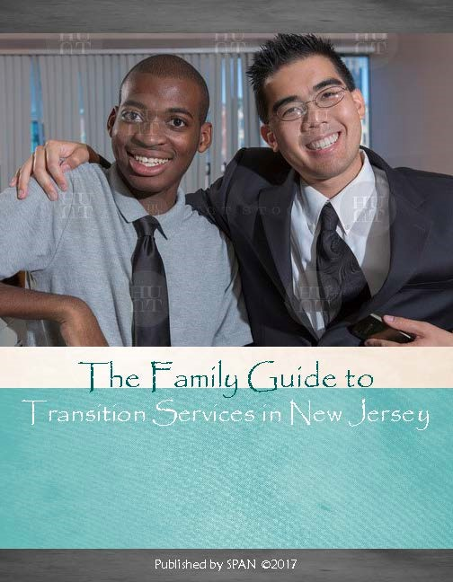
A Family Guide to
Transition Services
in New Jersey
Transition from
School to Adult Life

Slide 22
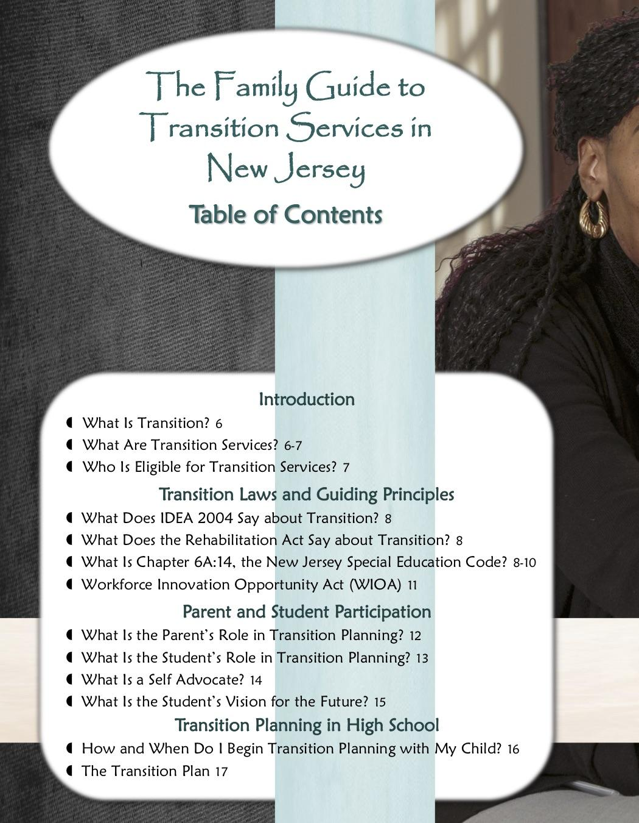
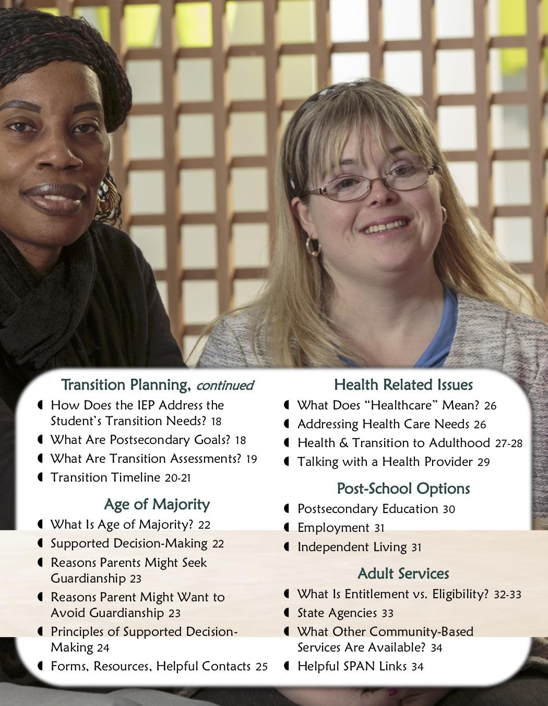
Transition from School to Adult Life
Notes:
A meaningful future requires:
Great expectations
Understanding abilities and disabilities
Understanding relevant laws and rights
Being aware of available resources
Building partnerships
Having a vision
Making a plan
All students with disabilities are eligible for special education services through the end of the school year in which they turn 21.
Once a student accepts a diploma, the right to special education and related services ends.
A student with a disability can participate in the graduation ceremonies with peers, without accepting a diploma. The student can receive a diploma after satisfying the goals, objectives and graduation requirements outlined in the IEP, or by June 30th in the school year in which he or she turns 21, whichever comes first.

Slide 23
Prior to Transition (Birth–12 years old)
Envision your child in the future as an adult.
Have conversations with your child about what they want for themselves.
Consider what skills your child needs to develop to become more independent.
Give your child responsibilities/chores as often as possible at home – create opportunities for success.
Transition Timeline
Page 20 & 21
Notes:
Transition planning is:
Helping youth/young adults decide:
What is my dream for the future?
What are my important ideas, values, people & things?
What is important for me to realize the life I want?

Slide 24
Ages 13-14
Help your youth:
be able to explain their disability
learn/practice informed decision making skills
learn to effectively communicate their interests, preferences, and needs.
identify personal learning style
request necessary accommodations in school and the workplace
learn and practice personal health care
consider options for future living arrangements including supports.
Transition Timeline
Page 20 & 21

Slide 25
Ages 15-16
Help your youth:
match career interests and skills with course work and community based learning
gather information on postsecondary programs
make arrangements for college entrance exam accommodations
learn and practice appropriate interpersonal, communication, and social skills
practice independent living skills
identify healthcare providers
become informed about sexuality and family planning issues
Transition Timeline
Page 20 & 21
Notes:
Match career interests and skills with vocational course work and community work experiences.
Gather more information on postsecondary programs and the support services offered, and make arrangements for accommodations to take college entrance exams.
ThinkCollege.net
DREAM programs for students with cognitive disabilities
Disability or student service offices
Disability Disclosure
Learn and practice appropriate interpersonal, communication, and social skills for different settings (employment, school, recreation, with peers, etc.).
Practice independent living skills (budgeting, shopping, cooking, housekeeping, etc.).
Identify healthcare providers and become informed about sexuality and family planning issues.

Slide 26
One Year
Before Leaving School
Help your youth:
identify public transportation options and apply as needed
identify and apply for appropriate postsecondary education options
determine health insurance coverage options
assume responsibility for health care needs
Transition Timeline
Page 20 & 21
Notes:
Identify public transportation options and apply as needed (New Jersey Transit reduced fare application; Access Link; county para-transit, etc.).
Identify and apply for appropriate postsecondary education options, and arrange for needed accommodations.
Identify health insurance coverage options and apply for Medicaid (if applicable) when student turns 18.
Assume responsibility for health care needs (making appointments, filling and taking prescriptions, etc

Slide 27
Why is transition important?
It is the end of a system of entitlements, and the beginning of a system of eligibility
Parent and Student Participation (pg. 12-15)
Notes:
Parents also have an important role in transition to adult life for their child with a disability. Transition is a lifelong process and doesn’t start at age 14. Even young children can begin to self-advocate by making choices.
Transition needs to start as early as possible and families play an important role in fostering their child’s independence.
What can families do?
Talk to their child about the future – support them, even when they may be unrealistic or you may disagree
Foster skill development- organization, social skills, decision making, time management
Provide career exploration opportunities- job shadowing, internships, paid work experiences
Encourage & support student’s participation
Emphasize career opportunities based on student interests and preferences
Build independence and leadership skills
Listen and support your child when discussing their interests and future goals, even if their ideas may seem unrealistic
Provide early career exploration activities such as opportunities to visit and discuss a variety of job/career opportunities through family outings, job shadowing experiences with family, relatives and friends
Emphasize through family and home activities the basic skills needed to succeed in school and the workplace such as: organization, decision-making, time management, problem-solving, and getting along with others
Monitor school assignments and capture opportunities to relate skills to the world of work and adult roles and responsibilities such as: relating math skills to budgeting; relating written and oral language assignments to interacting with employers, co-workers, the public; relating research assignments to collecting information that help make informed decisions
Encourage career-related activities during your child's spare time such as volunteering at a hospital or a veterinary clinic, odd jobs in the neighborhood
Build a relationship with your child's career or guidance counselor or transition specialist; ask for career information
Be available for visits or phone calls from your child's employer; if appropriate offer to provide first hand information or suggestions that may be helpful on the job
During transition planning meetings:
provide the team with information regarding your child's skills and behaviors at home, past experiences, and dreams and goals for your child
ask questions of teachers, counselors and your son or daughter regarding education and career options, labor market trends, community resources, specific family and student preferences and realities
Encourage your child to be a major player on the planning team and to talk about their interests, dreams and goals to the maximum extent possible
Emphasize Careers, Not Labels - the individualized assessment and planning of students should lead to placement according to the student's interests and preferences, not according to expectations based on "labels" or by what is available in the community
Focus on Work-Based Learning - many opportunities are available for real exploration and experiences in the world of work, including job-shadowing, internships and paid work experiences.
Listen to, support, build the independence & leadership of, your child/youth!

Slide 28
What is transition?
“a coordinated set of activities for a student designed within an outcome-oriented process, that promotes movement from school to post-school activities including postsecondary education, vocational training, integrated employment (including supported employment), continuing and adult education, adult services, independent living, or community participation. “
Introduction (pg. 6 -7)
Notes:
Services shall include: instruction, related services, community experiences, employment and other post-school adult living objectives, activities of daily living, and functional vocational assessment
Three years before the student turns 18 (at 15) a statement that the student has been informed of the rights that will transfer to the student on reaching the age of majority.
Instruction
Courses of study
Skill development
All students with disabilities are eligible for special education services through the end of the school year in which they turn 21.
Once a student accepts a diploma, the right to special education and related services ends.
A student with a disability can participate in the graduation ceremonies with peers, without accepting a diploma. The student can receive a diploma after satisfying the goals, objectives and graduation requirements outlined in the IEP, or by June 30th in the school year in which he or she turns 21, whichever comes first.

Slide 29
What are transition services?
Instruction, Related services, community experiences, employment and other post-school adult living objectives, activities of daily living and functional vocational assessment
Introduction (pg. 6 -7)
Notes:
Services shall include: instruction, related services, community experiences, employment and other post-school adult living objectives, activities of daily living, and functional vocational assessment
Three years before the student turns 18 (at 15) a statement that the student has been informed of the rights that will transfer to the student on reaching the age of majority.
Instruction
Courses of study
Skill development
All students with disabilities are eligible for special education services through the end of the school year in which they turn 21.
Once a student accepts a diploma, the right to special education and related services ends.
A student with a disability can participate in the graduation ceremonies with peers, without accepting a diploma. The student can receive a diploma after satisfying the goals, objectives and graduation requirements outlined in the IEP, or by June 30th in the school year in which he or she turns 21, whichever comes first.

Slide 30
Who is eligible for transition services?
All students with disabilities are eligible
Once a student accepts a diploma, the right to special education and related services ends.
A student with a disability can participate in the graduation ceremonies with peers, without accepting a diploma
Introduction (pg. 6 -7)
Notes:
Services shall include: instruction, related services, community experiences, employment and other post-school adult living objectives, activities of daily living, and functional vocational assessment
Three years before the student turns 18 (at 15) a statement that the student has been informed of the rights that will transfer to the student on reaching the age of majority.
Instruction
Courses of study
Skill development
All students with disabilities are eligible for special education services through the end of the school year in which they turn 21.
Once a student accepts a diploma, the right to special education and related services ends.
A student with a disability can participate in the graduation ceremonies with peers, without accepting a diploma. The student can receive a diploma after satisfying the goals, objectives and graduation requirements outlined in the IEP, or by June 30th in the school year in which he or she turns 21, whichever comes first.

Slide 31
What is the parent’s role in transition planning?
Teach skills
Encourage independence
Include student in goal setting and decisions for future
Support child’s decision making
Parent and Student Participation (pg. 12-15)
Notes:
Parents also have an important role in transition to adult life for their child with a disability. Transition is a lifelong process and doesn’t start at age 14. Even young children can begin to self-advocate by making choices.
Transition needs to start as early as possible and families play an important role in fostering their child’s independence.
What can families do?
Talk to their child about the future – support them, even when they may be unrealistic or you may disagree
Foster skill development- organization, social skills, decision making, time management
Provide career exploration opportunities- job shadowing, internships, paid work experiences
Encourage & support student’s participation
Emphasize career opportunities based on student interests and preferences
Build independence and leadership skills
Listen and support your child when discussing their interests and future goals, even if their ideas may seem unrealistic
Provide early career exploration activities such as opportunities to visit and discuss a variety of job/career opportunities through family outings, job shadowing experiences with family, relatives and friends
Emphasize through family and home activities the basic skills needed to succeed in school and the workplace such as: organization, decision-making, time management, problem-solving, and getting along with others
Monitor school assignments and capture opportunities to relate skills to the world of work and adult roles and responsibilities such as: relating math skills to budgeting; relating written and oral language assignments to interacting with employers, co-workers, the public; relating research assignments to collecting information that help make informed decisions
Encourage career-related activities during your child's spare time such as volunteering at a hospital or a veterinary clinic, odd jobs in the neighborhood
Build a relationship with your child's career or guidance counselor or transition specialist; ask for career information
Be available for visits or phone calls from your child's employer; if appropriate offer to provide first hand information or suggestions that may be helpful on the job
During transition planning meetings:
provide the team with information regarding your child's skills and behaviors at home, past experiences, and dreams and goals for your child
ask questions of teachers, counselors and your son or daughter regarding education and career options, labor market trends, community resources, specific family and student preferences and realities
Encourage your child to be a major player on the planning team and to talk about their interests, dreams and goals to the maximum extent possible
Emphasize Careers, Not Labels - the individualized assessment and planning of students should lead to placement according to the student's interests and preferences, not according to expectations based on "labels" or by what is available in the community
Focus on Work-Based Learning - many opportunities are available for real exploration and experiences in the world of work, including job-shadowing, internships and paid work experiences.
Listen to, support, build the independence & leadership of, your child/youth!

Slide 32
What is the student’s role?
Understand their disability
Understand disclosure
Use their voice
Parent and Student Participation (pg. 12-15)
Notes:
Parents also have an important role in transition to adult life for their child with a disability. Transition is a lifelong process and doesn’t start at age 14. Even young children can begin to self-advocate by making choices.
Transition needs to start as early as possible and families play an important role in fostering their child’s independence.
What can families do?
Talk to their child about the future – support them, even when they may be unrealistic or you may disagree
Foster skill development- organization, social skills, decision making, time management
Provide career exploration opportunities- job shadowing, internships, paid work experiences
Encourage & support student’s participation
Emphasize career opportunities based on student interests and preferences
Build independence and leadership skills
Listen and support your child when discussing their interests and future goals, even if their ideas may seem unrealistic
Provide early career exploration activities such as opportunities to visit and discuss a variety of job/career opportunities through family outings, job shadowing experiences with family, relatives and friends
Emphasize through family and home activities the basic skills needed to succeed in school and the workplace such as: organization, decision-making, time management, problem-solving, and getting along with others
Monitor school assignments and capture opportunities to relate skills to the world of work and adult roles and responsibilities such as: relating math skills to budgeting; relating written and oral language assignments to interacting with employers, co-workers, the public; relating research assignments to collecting information that help make informed decisions
Encourage career-related activities during your child's spare time such as volunteering at a hospital or a veterinary clinic, odd jobs in the neighborhood
Build a relationship with your child's career or guidance counselor or transition specialist; ask for career information
Be available for visits or phone calls from your child's employer; if appropriate offer to provide first hand information or suggestions that may be helpful on the job
During transition planning meetings:
provide the team with information regarding your child's skills and behaviors at home, past experiences, and dreams and goals for your child
ask questions of teachers, counselors and your son or daughter regarding education and career options, labor market trends, community resources, specific family and student preferences and realities
Encourage your child to be a major player on the planning team and to talk about their interests, dreams and goals to the maximum extent possible
Emphasize Careers, Not Labels - the individualized assessment and planning of students should lead to placement according to the student's interests and preferences, not according to expectations based on "labels" or by what is available in the community
Focus on Work-Based Learning - many opportunities are available for real exploration and experiences in the world of work, including job-shadowing, internships and paid work experiences.
Listen to, support, build the independence & leadership of, your child/youth!

Slide 33
What is a self-advocate?
Students in transition should be invited to participate at all meetings regarding their education and future – student led IEPs!
Goals to develop self determination and self advocacy skills can be included in transition IEP.
Building Self Advocates (pg. 14-15)
Notes:
NJ YELL: We help New Jersey youth/young adults by:
You want your parents to understand the importance of their Young adult learning to Self advocate.. Encourage the parent to have their young adult explore opportunities . Talk about NJ YELL: see below Youth empowerment groups help foster independence. See Exceptional Parent magazine article on NJYELL pgs. 24-27 http://reader.mediawiremobile.com/epmagazine/issues/202010/viewer?page=27.
Sharing information and resources for youth/young adults about how to access services, including transition to adult life services (education, health, community life, etc.)
Providing an opportunity for youth/young adults with and without special healthcare needs to work together to improve outcomes for New Jersey youth/young adults
Training youth/young adults about policy issues, self-advocacy, and available resources and supports
Reviewing materials aimed at youth/young adults and providing recommendations to make them more "youth and user friendly"
Helping them learn how to tell their story in ways that will make a difference in their home, school, community, and at state and national levels
Opportunities for youth:
NJ YELL http://www.spanadvocacy.org/content/youth-resources-empowerment
Family Voices national KASA (Kids as Self Advocates) http://www.fvkasa.org/index.php or Spanish http://fvkasa.org/espanol.php
NJCDD (NJ Council on Developmental Disabilities) https://njcdd.org/
SPAN factsheet Student Participation in the IEP Process SPAN factsheet Student Participation in the IEP Process - released 9/26-emailed Carolyn/Jeannette
Keeping it Real: How to Get the Supports You Need for the Life You Want (Eng./Span.) http://rwjms.rutgers.edu/boggscenter/products/KeepingItRealHowtoGettheSupportsYouNeedfortheLifeYouWant.html

Slide 34
How and when does transition planning begin?
Transition begins at 14 with a Statement of Transition Planning.
At 16 Transition Planning Statement of Transition Services (Coordinated Activities/Strategies)
Transition Planning in High School (pg. 16-21)
Notes:
Development of Individualized Plans for Employment (IPE), prior to graduation
There are 5 required Services:
Job Exploration
Counseling and Guidance
Work-based Learning Experiences
Workplace readiness
Self-advocacy

Slide 35
What should the transition planning include?
Instruction, Related Services, Community Experiences, Employment, Adult Living, Daily Living
Transition Planning in High School (pg. 16-21)
Notes:
Development of Individualized Plans for Employment (IPE), prior to graduation
There are 5 required Services:
Job Exploration
Counseling and Guidance
Work-based Learning Experiences
Workplace readiness
Self-advocacy

Slide 36
How does the IEP address student needs?
What are post-secondary goals
What are transition assessments? Independent living assessments? career assessments?
Transition Planning in High School (pg. 16-21)
Notes:
Often, post-secondary education isn’t considered for some students with disabilities. However, there are now programs for students with cognitive disabilities such as DREAM (Developing Real Expectations for Achieving Mastery) and others. There are many resources for students with disabilities considering college found at https://thinkcollege.net/.
All colleges have student services departments which can arrange accommodations such as distraction controlled testing if needed. Students have to right to chose whether they will disclose their disability.
Transition Assessments
determine appropriate post-HS outcomes
Vocational evaluations
Interest inventories
Independent living assessments
Psychological & educational testing
Independent living assessments
Help identify the supports your youth will need to live & work in the community
Communication support service providers
Interpreters
Augmentative communication systems
Other?
Ongoing process of collecting data on the individual’s needs, preferences, and interests as they relate to the demands of current and future working, educational, living, and personal and social environments. Assessment data serve as the common thread in the transition process and form the basis for defining goals and services to be included in the Individualized Education Program

Slide 37
What is age of majority?
District required to notify parents at least 3 years prior
Student becomes decision maker regardless of ability
How to use supported decision making as an alternative to guardianship.
Age of Majority
(pg. 22-25)
Notes:
Children have the right to make IEP & all other decisions at age 18 unless their parents are awarded guardianship
Guardianship takes away adult children’s civil rights
Supportive decision-making allows families & trusted circle of friends to be involved in decision-making while maintaining adult children’s civil rights
Instead of guardianship, families may want to consider alternatives rather than taking away their child’s rights. Various resources are found on the SPAN website which includes a recording of the webinar, SPAN factsheet, Autistic Self Advocacy Network toolkit “The Right to Make Choices” and the National Resource Center for Supported Decision-Making (“Everyone has the right to make choices.”)
1)
There are many reasons parents seek guardianship for their youth/young adult
Some are; educational concerns, medical or health concerns, fear of what will happen when parent no longer around
2)
To not make public declaration of incompetence
To limit court involvement in your life
To promote independence, dignity and freedom of choice
Children with special needs should have as much input as they can based on their capacity. Parents must begin at an early age to help their child – regardless of their disability or
special healthcare needs – engage in decision making about their own care and prepare them to make independent decisions as they become adults.

Slide 38
What does it mean to be a healthy adult?
How to address healthcare needs
Integrating healthcare into the transition IEP
Health Related Issues
(pg. 26-29)
Notes:
Healthcare is a critical issue for families as many young adults with special healthcare needs have difficulty finding the same access to quality care from adult health care providers. Planning for this transition should start early and includes building self advocacy skills to help youth/young adults partner with their health care providers to ensuring that connections to community supports are in place as needed.
Resources:
Being a Healthy Adult: How to Advocate for Your Health and Health Care
Boggs Center
“Take Control of Your Health” series
Family Voices New Hampshire
factsheets on medical appointments, medications, health information, and insurance
For Self-Advocates:
My Health Passport
ASAN toolkit-health care transition
Being a Healthy Adult: How to Advocate for Your Health and Health Care - Boggs Center
“Take Control of Your Health” series - Family Voices New Hampshire
And the AAP Caregiver Checklist- http://www.spanadvocacy.org/sites/g/files/g524681/f/files/CaregiverChecklist_RE_0.pdf

Slide 39
Postsecondary education
Employment
Transportation
Independent Living
Post-School Options
(pg. 30-31)
Notes:
Post-secondary education
What is realistic & appropriate?
What skills are needed to be successful?
Is your youth taking the regular HS tests?
Is your youth taking the ACT/SAT?
What accommodations are needed?
Are there others with deaf-blindness to meet?
Employment
What are the career goals?
What skills are needed for that job/career?
What skills are needed to know:
Where to find an available job
How to complete a job application
How to handle a job interview
How to get prepared?
Career awareness activities
Job sampling
Attendance at career seminars/conferences
Contact with adults with deaf-blindness
Career awareness
Local Chamber of Commerce
Local Workforce Investment Board
Summer employment
1 stop career youth center funds
Supported employment
3. Independent Living
Transportation
Orientation & mobility training
Food shopping, meal planning & preparation
Using money, making change
Personal hygiene
Living arrangements
Civic engagement
Accessing community resources
Places of worship
Social, recreational events
Shopping (food, clothes, etc.)
Youth volunteer programs
4. Health
Appropriate nutrition
Proper hygiene
Exercise
Effects of adverse chemicals
Reproductive education
Health insurance
Private? Medicaid?
Managed care?
Fee for service?
Health care
Who makes decisions?
Changing/choosing health care providers
Primary care physicians
Specialists
Resources:
Being a Healthy Adult: How to Advocate for Your Health and Health Care
Boggs Center
“Take Control of Your Health” series
Family Voices New Hampshire
factsheets on medical appointments, medications, health information, and insurance
For Self-Advocates:
My Health Passport for Children
ASAN toolkit-health care transition
Being a Healthy Adult: How to Advocate for Your Health and Health Care - Boggs Center
“Take Control of Your Health” series - Family Voices New Hampshire

Slide 40
Entitlement versus eligibility
Making connections: DRVS, DDD, CBVI, CILS, ASAN, Youth MOVE, Eye to Eye, KASA, REACH, RAISE, NTACT
Adult Services
(pg. 32-34)
Notes:
Entitlement
Entitlement is a guarantee of access to services for everyone who qualifies under state and federal law, special education services are an entitlement.
Once a student who is receiving special education services graduates (18 or 21) their entitlement ends.
Eligibility
They may be eligible for adult services only if they meet the eligibility criteria for adults agencies and programs.
Unlike special education, human services for adults with disabilities are contingent upon program availability and funding and there may be waiting lists for services. It is extremely important to start the application process for agency eligibility early.
Division of Vocational and Rehabilitation Services
http://careerconnections.nj.gov/careerconnections/plan/foryou/disable/steps_in_the_dvrs_process.shtml
Centers for Independent Living
www.njsilc.org
Department of Developmental Disabilities-services
http://www.state.nj.us/humanservices/ddd/services/
DDD approved provider listing https://irecord.dhs.state.nj.us/providersearch
REACH for Transition: Resources for Employment, Access, Community Living, and Hope
http://www.spanadvocacy.org/content/reach-transition-resources-employment-access-community-living-and-hope
National Resources for Access, Independence, Self-Advocacy and Employment (RAISE) Technical Assistance Center
http://www.spanadvocacy.org/content/national-raise-technical-assistance-center

Slide 41
HELPFUL HINTS
Don’t panic
Start planning early
Keep a paperwork binder
Include your youth/young adult
Have high expectations
REMEMBER:
Strong self advocacy skills lead to improved outcomes!

Slide 42
Reflection
Where are you now?
What do you still need to know?
What is your next step?
Notes:
Give participants time to digest, tell them to take a moment to jot down some notes right now. Open it up for questions.
USE WORKSHOP REFLECTION TOOL then discuss

Slide 43
Transition RESOURCES
SPAN PARENT ADVOCACY -
http://www.spannj.org/
https://spanadvocacy.org/downloads/transition-to-adulthood/
Transition from School to Adult Life -
GRADUATION, SECONDARY EDUCATION, EMPLOYMENT & INDEPENDENT
https://spanadvocacy.org/programs/transition/
REAL Transition Partners
RESOURCES FOR EMPLOYMENT, ACCESS, COMMUNITY LIVING, AND HOPE
https://spanadvocacy.org/programs/real/
Notes:
SPAN - main page and transition downloads which consist of :
Transition to Adult Life for Youth with Deaf-Blindness: A Parent Mini-Guide
Deaf-Blindness Educational Services Fact Sheet: Transition to Adult Life
Transition | A Guide to Assessing College Readiness
Tips for Adult Health Care Clinicians
Transition to Adult Life Resources for Health Practitioners
Youth in the Know
Insurance Options for Teens and Transitioning Youths...and much more!
Transition from School to Adult Life
GRADUATION, SECONDARY EDUCATION, EMPLOYMENT & INDEPENDENT LIVING - Providing information, training, and technical assistance for youth, their families,
and professionals in order to support informed and effective transition from school to adult life for youth with disabilities
REAL Transition Partners- RESOURCES FOR EMPLOYMENT, ACCESS, COMMUNITY LIVING, AND HOPE

Slide 44
QUESTIONS
About any
of these
rights?

Slide 45
for joining us for this presentation
For more information contact us at:
SPAN
35 Halsey Street, 4th Floor
Newark, NJ 07102
Phone: 973-642-8100
Toll Free: 800-654-SPAN
Fax: 973-642-8080
www.spanadvocacy.org
Notes:
Thank the group for their time, ask if there are any questions, ask/thank for completing evaluation forms. Allow 10-15 minutes for questions, completing evaluations. Advise the group that individual questions can be addressed by our technical assistance staff by calling the office.

